Slide 1
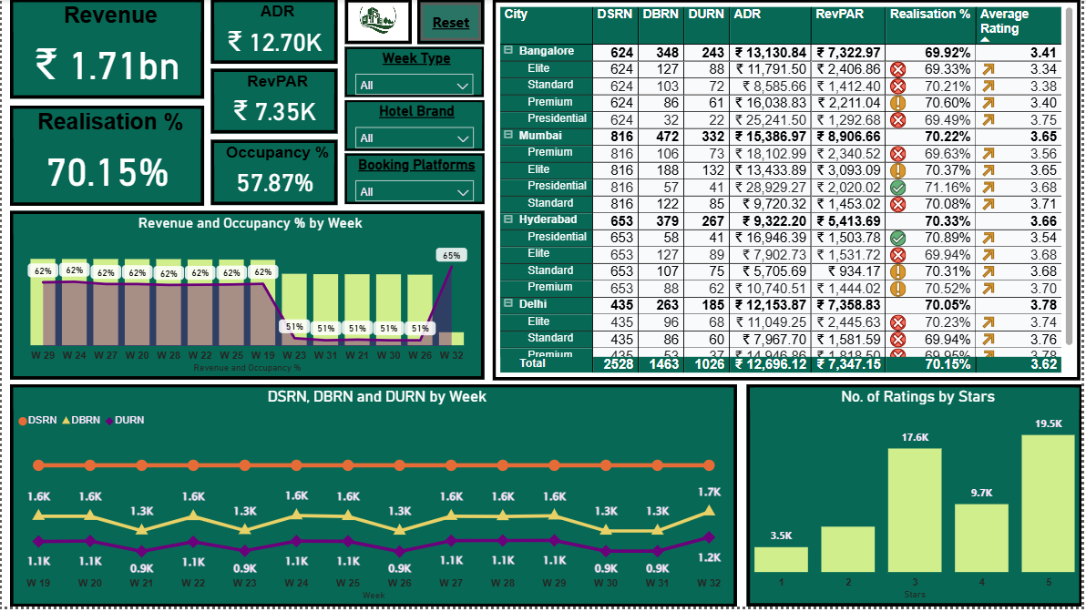
Atliq Hotel
Performance & Guest Behavior
Team Members
Shraddha Mahavir Chandole
Syed Safiya
Rajdeep Anil Kudalkar
Shakila Samsher Ali
Salim Bilal Sayyed
Dokka Jashuva Daniel
Samstabraj khan
Team Would Like to Thank
Abirami R for Guidance throughout Project building process

Slide 2
Introduction
Our team analyzed Atliq Hotels’s business performance, guest booking behavior, platform dependency, and customer satisfaction to identify opportunities for revenue growth and operational excellence.
This presentation focuses on dashboard-driven insights and data-backed recommendations to help Atliq Hotels strengthen its market position while improving accessibility and user-centric dashboard design.

Slide 3
Business Objective
The dashboard analysis aims to support Atliq Hotels in achieving the following strategic objectives:
Enhance Revenue & Profitability
Reduce OTA Dependency & Boost Direct Bookings
Improve Guest Experience & Ratings
Optimize Property Performance
Support Strategic Growth & Expansion

Slide 4
Overall Business Performance
Strong Revenue and ADR across all cities and Properties
Healthy Average RevPAR across all cities and Properties
Overall occupancy at 58%, below target
Need to optimize utilization across metros

Slide 5
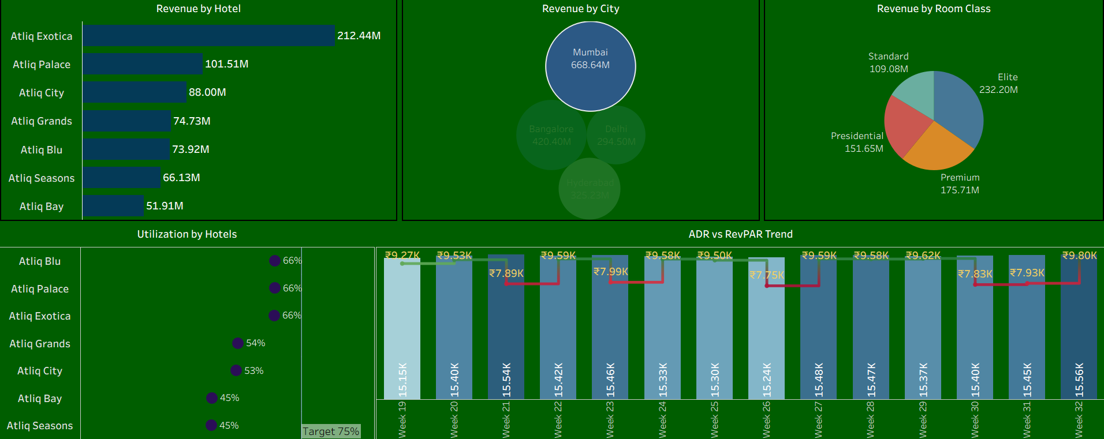
Mumbai Performance (Leader Market)
39% of total revenue (highest)
Exotica, Blu, Palace driving RevPAR ~₹9K
Most hotels >50% occupancy; Bay & Seasons ~45%
Strong revenue, occupancy improvement needed

Slide 6
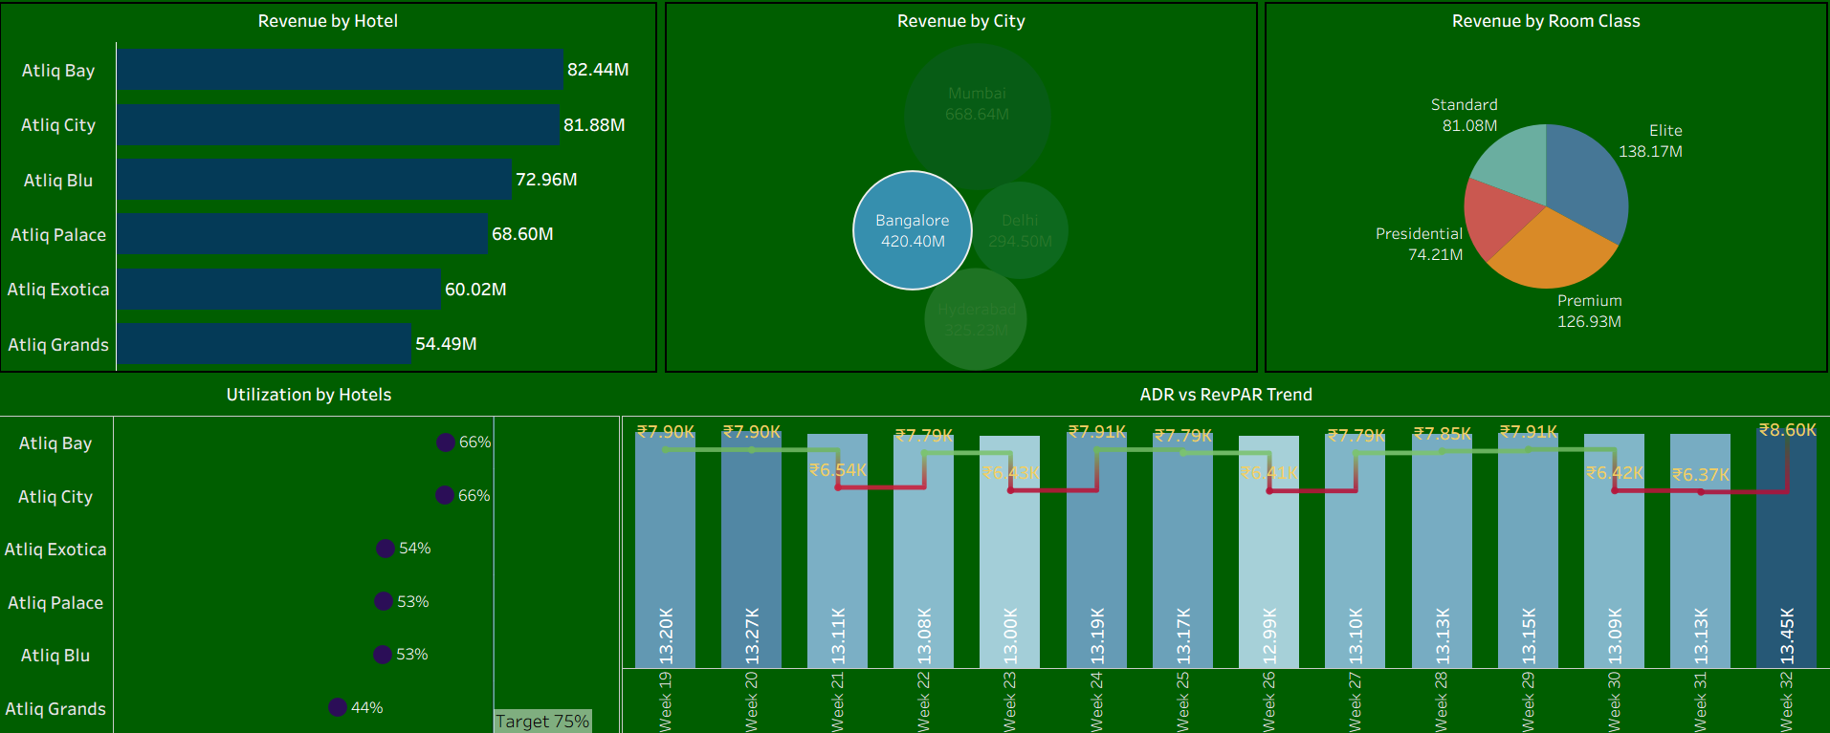
Bangalore Performance (Under-Utilized Market)
Revenue ~₹420M
Bay, City, Blue performing well
Grands underperforms across metrics
Lowest occupancy at 56%
Focus on improving utilization

Slide 7
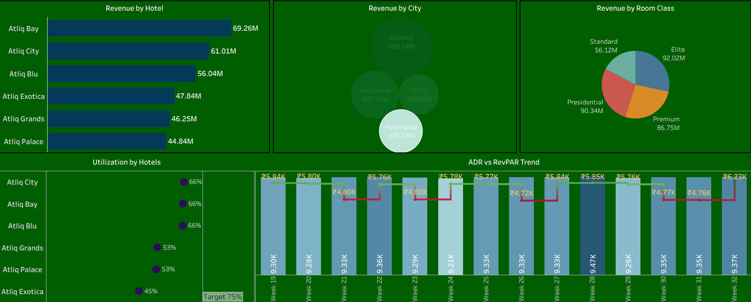
Hyderabad Performance (Balanced Performer)
Revenue ₹325M
Bay, City, Blue strong; Grands weak
Lowest RevPAR ₹5.41K
Occupancy 61% (2nd highest)

Slide 8
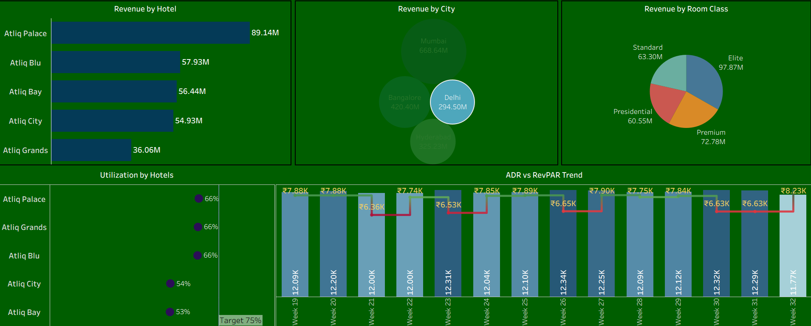
Delhi Performance (High-Growth Market)
Revenue ₹295M
Palace, Blue, Bay leading metrics
RevPAR ₹7.36K; highest occupancy ~65%
Balanced room class demand
Expansion potential in business segment

Slide 9
Key KPI Overview
Total Bookings: 134.59K
Cancellation %: 24.83%
No-Show %: 5.02%
ASD: 2.4
Overall booking activity is strong, but cancellations remain high.

Slide 10
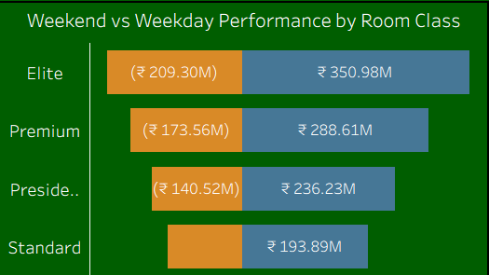
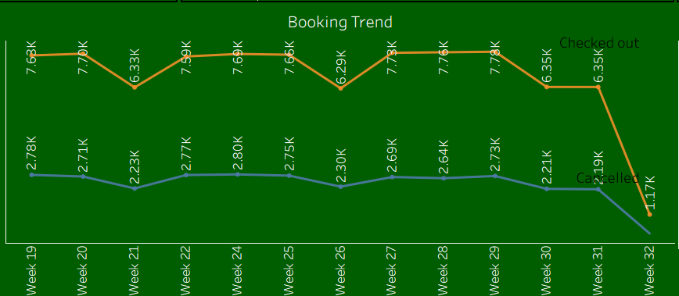
Bookings Volume Behavior
Weekly check-outs stable around 4.7K – 4.9K.
Indicates consistent guest flow and strong operational throughput.
Weekday Bookings > Weekend Bookings, resulting in more weekday revenue

Slide 11
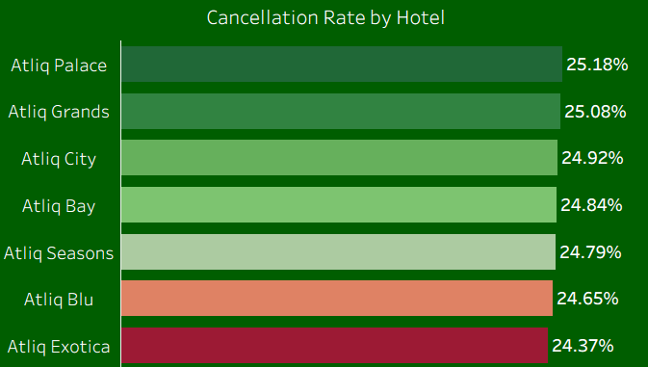
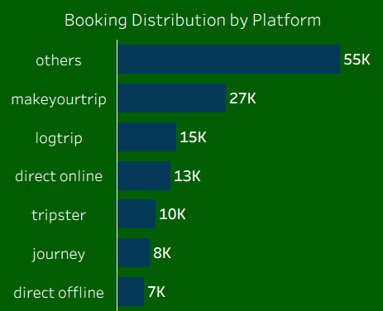
Bookings Channel Distribution & Cancellation
Aggregators/Third-Part bookings (Others) at 34K (40%)
OTAs: MakeYourTrip 17K, LogTrip 9K
Direct bookings low at 8K
Cancellation rate 24–25% across markets
Likely due to OTA reliance, flexible policies

Slide 12
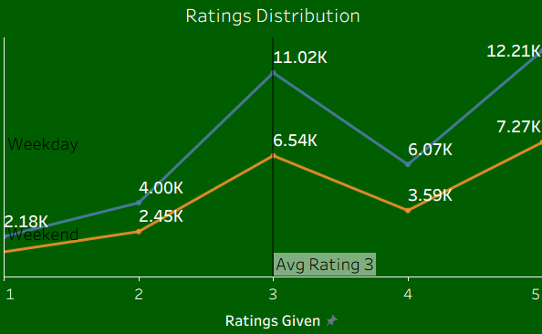
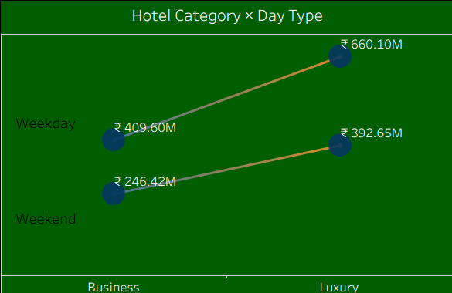
Weekday vs Weekend & Ratings Overview
Luxury leads: ₹660M weekday, ₹392M weekend
Business: ₹409M weekday, ₹246M weekend
Strong premium demand → expand high-end inventory
Average rating = 3 (moderate) across business & luxury
Better ratings on weekdays vs weekends
Weekend service drops due to operational strain

Slide 13
Recommendations: Revenue Growth & Business Expansion
Strengthen Direct Booking Channels
OTA dependency high (40%+ from “Others”).
Improve direct website campaigns, loyalty programs, member-rates.
Reduce commission costs and build direct customer relationships.
Dynamic Pricing & Revenue Optimization
ADR strong across markets but occupancy low → adjust pricing.
Implement city-level dynamic pricing & event-based surcharges.
Reduce unnecessary discounts during peak demand weeks.
Expand Premium & High-Demand Inventory
Luxury hotels deliver highest weekday/weekend revenue.
Consider expanding premium inventory and renovating high-revenue properties.
Support business-class hotels with enhanced amenities & corporate packages.
Strengthen Corporate Partnerships
ASD (2.7 days) indicates business-heavy demand.
Expand corporate tie-ups, long-stay packages, and conference offerings.
Key focus cities: Delhi, Mumbai, Bangalore.

Slide 14
Recommendations: Operational & Service Excellence
Improve Occupancy & Property Performance
Overall occupancy at 58%—needs targeted improvement.
Focus on underperformers: Grands, Bay, Seasons, and select Mumbai/Bangalore properties.
Optimize room utilization strategies across metros.
Enhance Guest Experience & Ratings
Average rating = 3 (moderate) → service gaps.
Weekend service drop → strengthen weekend staffing & training.
Implement real-time guest feedback and issue resolution.
Address Cancellation & No-Show Issues
Cancellation: 24–25%; No-show: 5% → systemic issue.
Tighten policies and encourage prepaid / non-refundable bookings.
Improve communication & reminders, especially for OTA guests.
Improve Weekend & Leisure Performance
Weekdays outperform weekends across all metrics.
Launch weekend packages, leisure bundles, event-based promotions.
Aim to balance corporate-heavy demand with leisure-driven stays.

